Slide 1
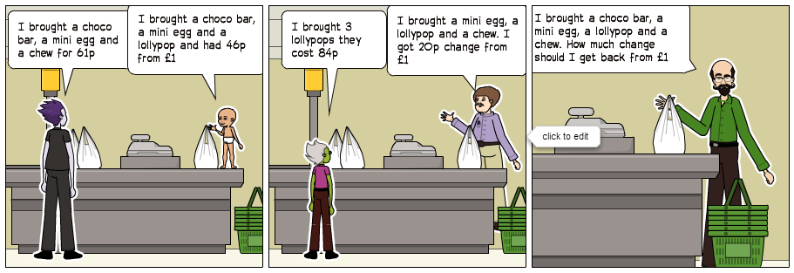
Sweet Shop
NRICH
LO: Use mathematical reasoning to find unknown values
Five children went into the sweet shop after school. They looked at the things that cost under 50p. There were choco bars, chews, mini eggs and lollypops.
Each of the children had a £1 coin they could spend, but they didn't necessarily want to spend all of it!.
Questions
Nathan bought one of each - a choco bar, a mini egg, a lollypop and a chew. How much change did he get from his £1?
Suggest a way in which Nathan could spend all his money.
Make sure you show your working out on the answer sheet
EXTENSION: How many different ways can Nathan spend exactly £1

Slide 2
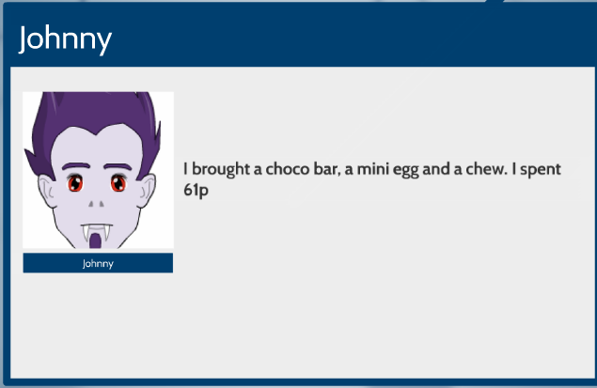
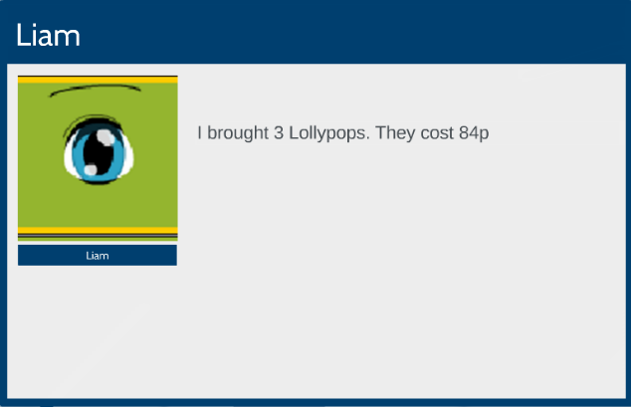
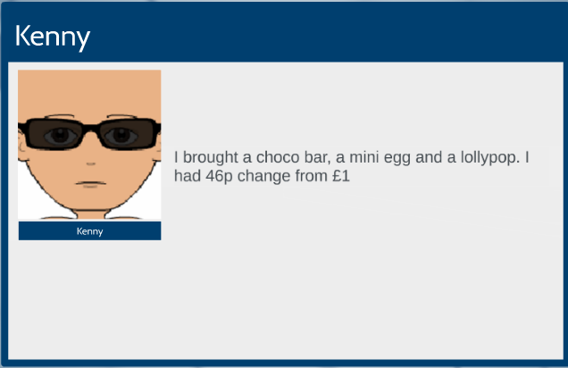
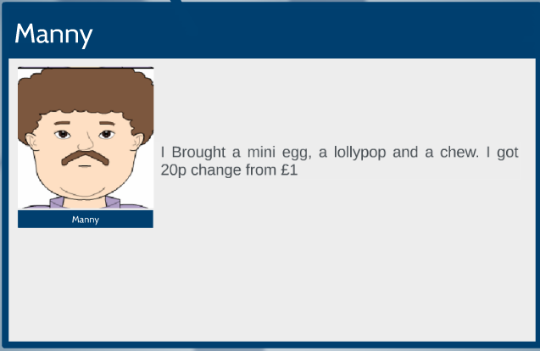

Sweet Shop
NRICH
LO: Use mathematical reasoning to find unknown values
Five children went into the sweet shop after school. They looked at the things that cost under 50p. There were choco bars, chews, mini eggs and lollypops.
Each of the children had a £1 coin they could spend, but they didn't necessarily want to spend all of it!.
Questions
Nathan bought one of each - a choco bar, a mini egg, a lollypop and a chew. How much change did he get from his £1?
Suggest a way in which Nathan could spend all his money.
Make sure you show your working out on the answer sheet
EXTENSION: How many different ways can Nathan spend exactly £1

Slide 3

Sweet Shop
LO: Use mathematical reasoning to find unknown values
Five children went into the sweet shop after school. They looked at the things that cost under 50p. There were choco bars, chews, mini eggs and lollypops.
NRICH
Each of the children had a £1 coin they could spend, but they didn't necessarily want to spend all of it!
Johnny bought a choco bar, a mini egg and a chew. She spent 61p.
Kenny bought a choco bar, a mini egg and a lollypop. He had 46p change from his £1.
Leah bought 3 lollypops. They cost 84p.
Manny bought a mini egg, a lollypop and a chew. She had 20p change from her £1.
Questions
Nathan bought one of each - a choco bar, a mini egg, a lollypop and a chew. How much change did he get from his £1?
Suggest a way in which Nathan could spend all his money.
Make sure you show your working out on the answer sheet
EXTENSION: How many different ways can Nathan spend exactly £1

Slide 4
Support questions:
How much does 1 lollypop cost? Show your working out.
How much money did Kenny Spend? Show your working out.
Would it be a good idea to see what Kenny bought? Why?
Can you compare what Kenny bought to what Johnny bought? How?
How could you work out how much a chew cost? Show your working out.
Can you use the information you have found so far to work out the cost of a mini egg?
Support questions:
How much does 1 lollypop cost? Show your working out.
How much money did Kenny Spend? Show your working out.
Would it be a good idea to see what Kenny bought? Why?
Can you compare what Kenny bought to what Johnny bought? How?
How could you work out how much a chew cost? Show your working out.
Can you use the information you have found so far to work out the cost of a mini egg?

Slide 5

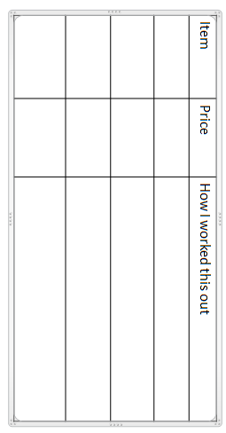
Name___________
Name___________
Date___________
Date___________

Slide 6
Sweet Shop
Stage: 3
Five children went into the sweet shop after school. They looked at the things that cost under 50p. There were choco bars, chews, mini eggs and lollypops.
Answers
Each of the children had a £1 coin they could spend, but they didn't necessarily want to spend all of it!
Judy bought a choco bar, a mini egg and a chew. She spent 61p.
Kenny bought a choco bar, a mini egg and a lollypop. He had 46p change from his £1.
Kenny spent 54p and Chews are 7p more than lolly
Liam bought 3 lollypops. They cost 84p.
One lollipop is 28p, so chews are 35p
Mandy bought a mini egg, a lollypop and a chew. She had 20p change from her £1.
Mandy spent 80p, 80p –28p - 35p = 17p ( price of mini eggs) lolly
So if Judy bought a choco bar, a mini egg (17p) and a chew (35p). She spent 61p.
Choco bar must be 61p – 17p – 35p = 9p

Slide 7
The cartoon strip was created on www.pixton.com

