Slide 1
In this INTERACTVE session we will EXPLORE the recent INNOVATIONS and DEVELOPMENTS on the NRICH website designed to HELP the DEVELOPMENT OF EAS. We will DISCUSS THE SPEICAL NEEDS of EAS and the DIFFICULTIES FACING THEIR TEACHERS and of course HAVE A GO at the problems themselves. MATHEMATICALLY LESS CONFIDENT teachers very welcome

Slide 2

using
to support
NRICH
their
students
exceptionally able
and
at
teachers
key stages
4 and 5
What caught your mathematical attention at school?
Who was mathematically important to you?
What helped you? What hindered you?
Why did you end up where you are now?

Slide 3

How to grow exceptional mathematicians – traditional recipe
Find a suitable seed from a well-educated /well-off family.
Plant seed in a primary school with great traditional values and a G&T policy.
Transplant seedling age 11 to an expensive school (grammar/state selective as second option).
Apply GCSEs in year 9 and A-levels in year 11 (cook individually at high temperature).
Thoroughly fertilise with university preparation.
Well done, your seed got great scores.

Slide 4
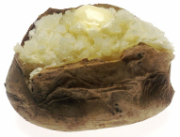
Apologies in advance for any burnt tongues!!

Slide 5
What is a mathematically exceptional child?
... are these exceptional?
“Whilst in primary school doing quadratic equations I didn’t know how to do them. Then I suddenly realised they were really easy and from then on I’ve been good at maths.”
“I Took GCSE when I was 9.”
“I taught myself most of high school mathematics (except calculus) by the end of primary school and then worked on IMO questions.”
“Did KS3 SATS year 8, GCSEs year 9, A level maths year 10, Further Maths A-level year 12.”
“Taught 11+ material age 9; began A-level syllabus in first year of secondary school.”
“I first realised I enjoyed solving difficult mathematics problems when I entered the Mathematics Olympiad in year 7.”
II.1
II.1
II.1
1
II.2
II.2

Slide 6
VISUALISE THE EXCEPTIONS YOU HAVE MET
Who were they?
What did they look like? What did they do?
How did you know that they were exceptional? How did you know?
In hindsight, did you look after them well? How do you know?

Slide 7
Top 5 myths about mathematically exceptional children
My C/D kids need me more
It must be great being exceptional
They will succeed anyway
A university number theory text book will do the trick
They must be good at poker or mental arithmetic

Slide 8
Major development: NRICH research
We asked the Cambridge University STEM students to give us their views on their mathematics education, from primary school right through to university level.
We collected masses of quantitative and qualitative data.
More work is ongoing. It is very exciting!

Slide 9
What did we ask about?
When/why did they choose their university course?
Received teaching and schooling.
Perceptions of mathematics.
Approaches to learning and doing mathematics.
Views of their own mathematical ability.
Their acceleration through the curriculum.
What were their key mathematical moments?
All questions asked from primary school through to university
Several options and comment boxes given.
We received A LOT of HONEST comment on various HOT TOPICS.

Slide 10
Some overall key moments as reported by students ....
... are these the result of a successful schooling?
1
1
1
1
With ‘rediscovering’ maths at sixth form I taught myself a lot of stuff on calculus and analysis and rigorous proof, which I found fascinating and really got me excited about maths in general.
My teacher for GCSE set aside a week every now and then to study something off-syllabus ...(these) changed my views on mathematics from thinking it was merely equations to understanding how fundamental it is.
In a particular area of mathematics that I just started to learn all the new things just don’t make sense, I notice a little key bit, or just because of spending some time thinking about it, the whole starts to form a big picture, and suddenly I see deeper connections and I have a much more stable and deep understanding.
Most people believe that mathematics is about the ‘correct answer’. Actually, this is not true. Mathematics is more about the journey one takes in solving a problem and this is what I realised as I matured in the subject and that it why I study it.

Slide 11
Some overall key moments as reported by students ...
... are these the result of a successful schooling?
Continually doing very well in tests etc. affirmed the belief that maths was something I was good at.
Primary – getting 100% in SATS mock. Sixth form – passing STEP.
Being highly successful at 6th form made me realise perhaps I might ... successfully pursue mathematics at Cambridge.
At the start of year 11, my maths teacher decided that, since I found GCSE work easy I should try working on A-level problems, and took some A-level exams in year 11.
III
II.2
III
II.1

Slide 12
Basic message – good teaching rules!
α – Provide regular stimulation in lessons
β – Cover a range of ideas, topics, styles and contexts
γ – Give opportunities for becoming mathematically socialised
δ – Facilitate meaningful independent study
ε – Don’t accelerate purposelessly
We have been thinking hard how to help teachers do this ...

Slide 13
Major development – Weekly Challenges
Shorter tasks for easier insertion.
Designed to cover a wide range of mathematical ideas and concepts.
Designed to naturally incorporate extension and enrichment.
Immediate links for the interested.
There will be a cycle of 52 to enable planning.
Good for homework, display, self-study, group starters, maths clubs.

Slide 14
TASK

Slide 16
Top 5 difficulties facing teachers
I am under-confident and the stakes are too high to experiment
Parental/departmental/Govian pressure for traditionalism
There is no time for rich tasks
I don’t have time to search for resources
I got a third, or I don’t have a maths degree

Slide 17
Major development – KS 4/5 transitions
Parallel tasks with KS4 and KS5 content.
Try at KS4 or KS3 first to get confidence.
Use KS5 tasks as extension for highly able.
Use KS4 tasks as revision for A-level.
These will all appear on the brand new KS5 curriculum mapping document.

Slide 18
Task together

Slide 19
Common trajectories of EMG students
Finance
Technology
Pure Maths
Physics
Teaching
Applied Maths
Industry
Research
Unemployment
Chemistry
Statistics
Academia
Bio-tech
Music
Coding
Undefined future job
Hospital
Computer science

Slide 20
Major Development – stemNRICH KS 3&4
Because maths is everywhere.
Because curriculum silos are artificial.
Because the modern world is STEM.
Because students might want to do different things in life.
Because Clothworkers were very generous....

Slide 21
TASK

Slide 22
Lucky escapes?
I was bored for most of the first 11 years and was lucky not to be turned off. I had the occasional bit of support or interest which kept me going. I am happier now I’m at university and being satisfactorily challenged.
After deciding to go to Cambridge I realised I had to pass STEP and I realised that I had a lot of work to do ... meeting my offer was a great lesson in perseverance and hard work that other school work had never required.
Being aware of UKMT before Y13 would have been good for me.
GCSEs are the worst possible way to teach mathematics at school and must be changed. After not paying a single bit of attention to any GCSE maths lesson I still managed to walk out with an easy A* ... (lots more) .. I found myself starting university on the back foot compared to others, not only in the content they had learned but the level of abstraction and proof they were introduced to before university.
I
II.1
II.1
II.1

Slide 23
How to grow exceptional mathematicians – new recipe
Take a batch of seeds
Plant seeds in a great primary school and expose all to rich mathematics
n.b. some will demand extra nourishment, especially when taking root
Transplant seedlings aged 11 to a great secondary school and expose all to rich mathematics
n.b. some will demand extra nourishment, especially when starting to flower
!! Be aware that many plants might need special care at times to ensure growth !!
Apply examinations where necessary
Well done, your seeds grew well (and scored well)

Slide 24
You should not be on this slide

Slide 25
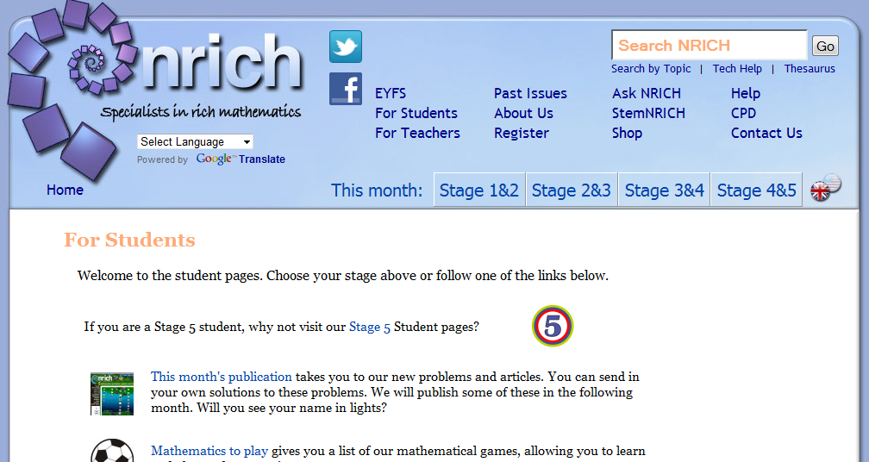

Slide 26
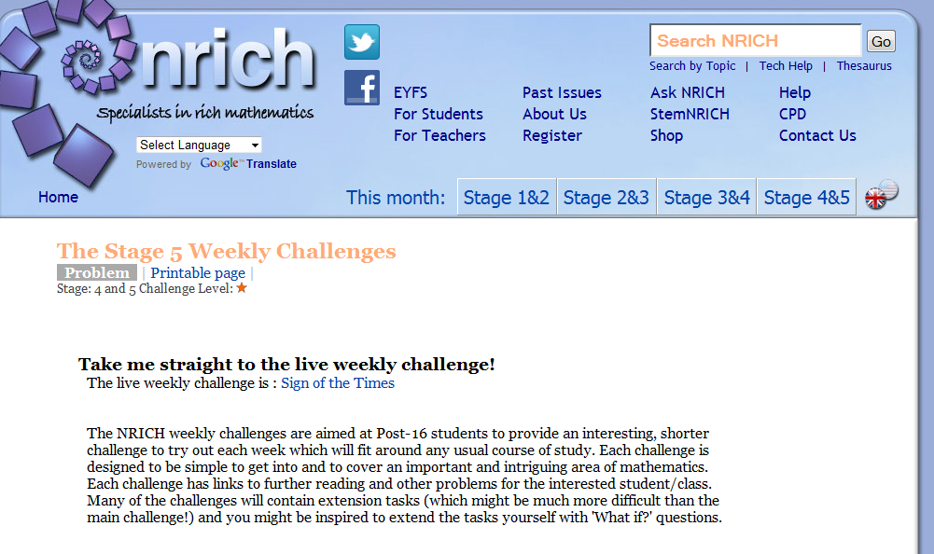

Slide 27
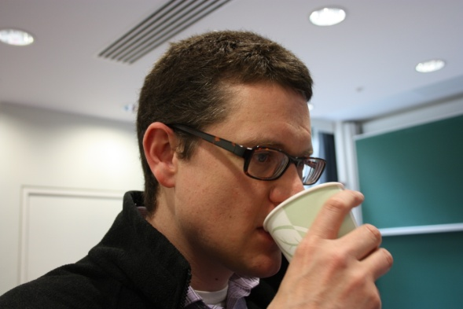
My basic vision of the maths classroom
Every child has the right to experience success
Every child has the right to be stuck
Every child has the right to be happy
  I think that exceptional young mathematicians often experience none of these whilst at school.

Slide 28
Where are we now:
Main decisions for next phase of research
Are there meaningful and identifiable profiles of student experience and views of mathematics?
How do social aspects of mathematics become important and lead to university success?
What is the correct balance of acceleration vs. enrichment for exceptionally able students?
PLAN OF ACTION
Devise key student profiles based on a mixed analysis of data a student comments
Interview key students to refine our ideas
Devise a rigorous and focussed follow-up survey for mathematicians
Plan, develop and evaluate an intervention strategy for each profile.

