Slide 1
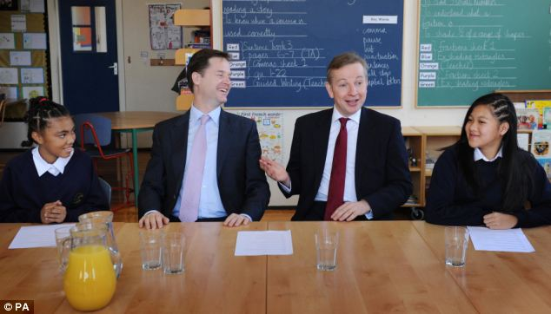
Isn’t it the case that there ain’t nothin’ that you wouldn’t do for all of your students if you were a teacher?
... or, why do we teach?

Slide 2
What should drive education?
The quest for 5 or more GCSEs, grades A* to C
A desire to follow procedure from ‘superiors’
Keeping classes and their parents quiet and settled
The examination system and getting students through it as quickly as possible
The past: long division didn’t do me any harm and I still say my times tables every night before bed

Slide 3

How to teach – modern recipe
Obtain a grade B in mathematics GCSE
Obtain a good degree in your chosen subject
Train on the job by watching a few teachers in action
Transmit your knowledge to the children in small, carefully sanitised pieces at the appropriate times in the approved manner (5 or 7 years per child, depending on whether or not they are successful)
Be sure to refer to examinations in your specific subject at all times
Well done. Your students are educated.

Slide 4
Some overall key moments as reported by students ...
... are these the result of a successful schooling?
Continually doing very well in tests etc. affirmed the belief that maths was something I was good at.
Primary – getting 100% in SATS mock. Sixth form – passing STEP.
At the start of year 11, my maths teacher decided that, since I found GCSE work easy I should try working on A-level problems, and took some A-level exams in year 11.

Slide 5
What is education all about? Some opinions.
Education is not filling a pail but the lighting of a fire (Yeats)
The aim of education should be to teach us rather how to think, than what to think - rather to improve our minds, so as to enable us to think for ourselves, than to load the memory with thoughts of other men. ~Bill Beattie
The object of education is to prepare the young to educate themselves throughout their lives. ~Robert Maynard Hutchins
Education is what remains after one has forgotten what one has learned in school. ~Einstein
Education is an ornament in prosperity and a refuge in adversity. ~Aristotle
An educational system isn't worth a great deal if it teaches young people how to make a living but doesn't teach them how to make a life. ~Author Unknown
The whole purpose of education is to turn mirrors into windows. ~Sydney J. Harris

Slide 6
Some overall key moments as reported by students ....
... are these the result of a successful schooling?
My teacher for GCSE set aside a week every now and then to study something off-syllabus ...(these) changed my views on mathematics from thinking it was merely equations to understanding how fundamental it is.
In a particular area of mathematics that I just started to learn all the new things just don’t make sense, I notice a little key bit, or just because of spending some time thinking about it, the whole starts to form a big picture, and suddenly I see deeper connections and I have a much more stable and deep understanding.
Most people believe that mathematics is about the ‘correct answer’. Actually, this is not true. Mathematics is more about the journey one takes in solving a problem and this is what I realised as I matured in the subject and that it why I study it.

Slide 7
What do students find interesting?
I don’t know.
I do, however, know lots of things I find interesting.
I think that all students are interested in lots of things.
I think that students work harder when interested and motivated than not.
Time to go fishing!

Slide 8
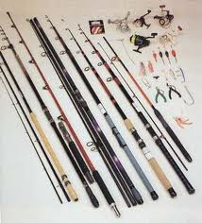


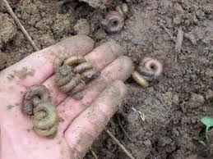
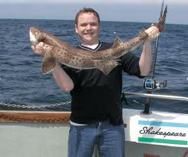
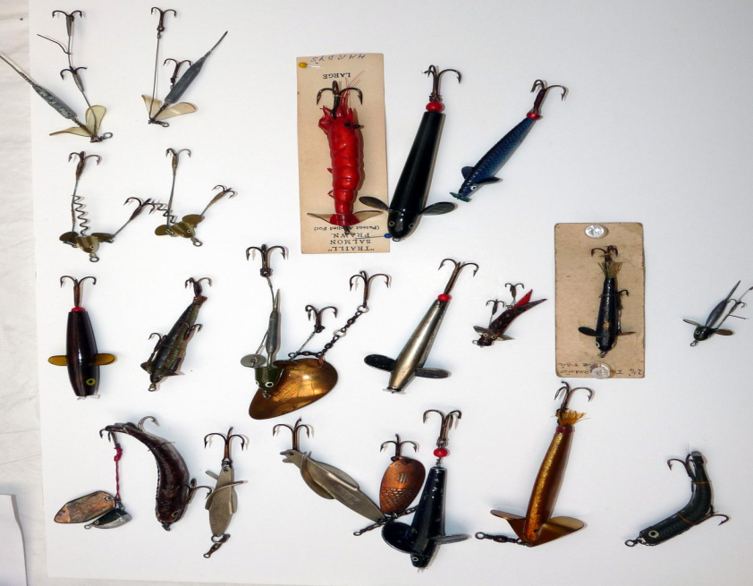
Gone fishin’

Slide 9

Education is not filling a pail but the lighting of a fire (Yeats)

