Slide 1
Introduction to the
Lorentz Transformation

Slide 2
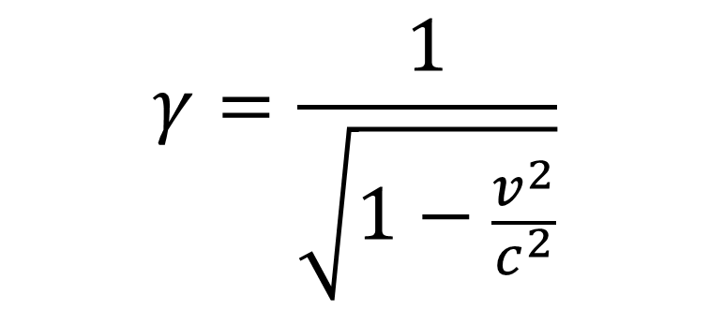
The Lorentz Contraction
$$γ=\frac{1}{\sqrt{1−\frac{v^{2}}{c^{2}}}}$$
this is gamma – the third letter of the Greek alphabet
v = speed of the object (in m/s)
c = speed of light 300,000,000 m/s which is 3×10⁸ m/s
m/s is often written as ms⁻¹

Slide 3
The Lorentz Contraction
$$γ=\frac{1}{\sqrt{1−\frac{v^{2}}{c^{2}}}}$$
This allows us to calculate the observed length, time and mass of an object when it is travelling close to the speed of light. You need to calculate γ for a scenario and then apply it to the relevant relativistic equation.

Slide 4
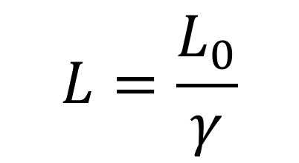
The Lorentz Contraction
$$γ=\frac{1}{\sqrt{1−\frac{v^{2}}{c^{2}}}}$$
Length contraction states that the original Length (L_{o}) of an object gets smaller, according to an external (stationary) observer, when travelling close to the speed of light (c). This new length is L.
$$L=\frac{L_{0}}{γ}$$

Slide 5
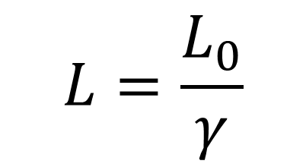
The Lorentz Contraction
$$γ=\frac{1}{\sqrt{1−\frac{v^{2}}{c^{2}}}}$$
$$L=\frac{L_{0}}{γ}$$
Jim has a problem. His garage is 4 metres long, but his ladder is 5 metres. The ladder won’t fit!
[We will assume Jim isn’t clued up enough to consider putting it diagonally …]
5 metres
4 metres

Slide 6
The Lorentz Contraction
$$γ=\frac{1}{\sqrt{1−\frac{v^{2}}{c^{2}}}}$$
$$L=\frac{L_{0}}{γ}$$
Jim realises that, to a stationary observer, his ladder will shrink if he runs very fast with it. He decides to calculate how fast he will need to run so the observed length of his 5m ladder becomes 4m and it will therefore fit into his garage.
[He doesn’t, unfortunately, consider what will happen a moment later, but hey – science can be dangerous!]

Slide 7

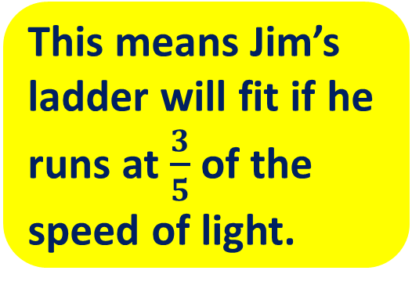
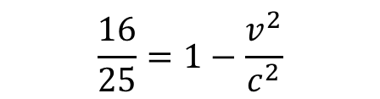

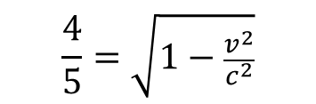

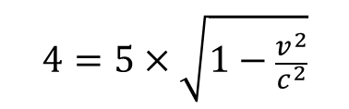

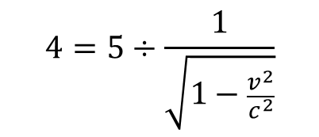

The Lorentz Contraction
$$γ=\frac{1}{\sqrt{1−\frac{v^{2}}{c^{2}}}}$$
$$L=\frac{L_{0}}{γ}$$
$$4=5÷γ$$
$$4=5÷\frac{1}{\sqrt{1−\frac{v^{2}}{c^{2}}}}$$
So: L₀ = 5 metres and L = 4 metres
$$\frac{v^{2}}{c^{2}}=1−\frac{16}{25}$$
$$\frac{v^{2}}{c^{2}}=\frac{9}{25}$$
$$4=5×\sqrt{1−\frac{v^{2}}{c^{2}}}$$
This means Jim’s ladder will fit if he runs at $\frac{3}{5}$ of the speed of light.
$$\frac{4}{5}=\sqrt{1−\frac{v^{2}}{c^{2}}}$$
$$\frac{v}{c}=\frac{3}{5}$$
$$\frac{16}{25}=1−\frac{v^{2}}{c^{2}}$$
$$v=\frac{3}{5}c$$

Slide 8
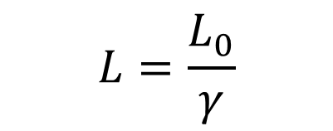


The Lorentz Contraction
$$γ=\frac{1}{\sqrt{1−\frac{v^{2}}{c^{2}}}}$$
Length contraction compares the original length L_{o} and the new length L.
$$L=\frac{L_{0}}{γ}$$
Time dilation compares T_{o} (time on clock at rest) with the new, slower time T.
$$T=γT_{0}$$
Mass increase compares M_{o} (original mass at rest) with the new, increased mass M.
$$M=γM_{0}$$

