Slide 1
Olympic Opening Patterns

Slide 2
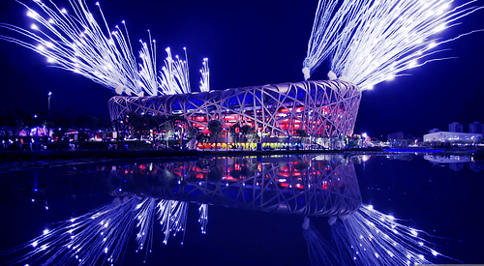
Notes:
Pic 9
Flickr "hto2008" http://www.independentagenda.com/economy-and-markets/china-has-peaked/

Slide 3
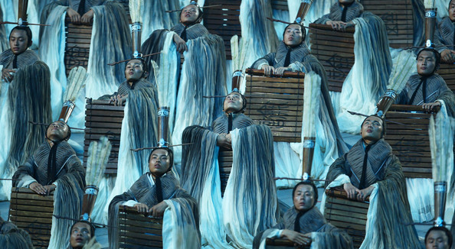
Notes:
Pic 8
Vladimir Rys/Bongarts http://www.zimbio.com/2008+Olympic+Pictures/articles/50/PICTURES+2008+Beijing+Olympics+Opening+Ceremony

Slide 4
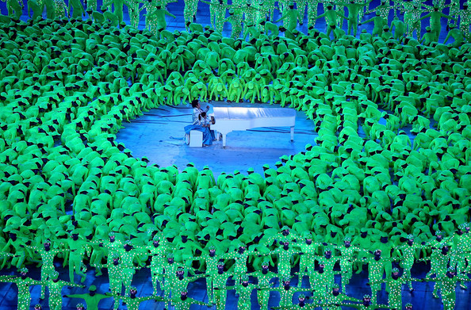
Notes:
Pic 7
Adam Pretty/Getty Images AsiaPac http://www.zimbio.com/2008+Olympic+Pictures/articles/50/PICTURES+2008+Beijing+Olympics+Opening+Ceremony

Slide 5
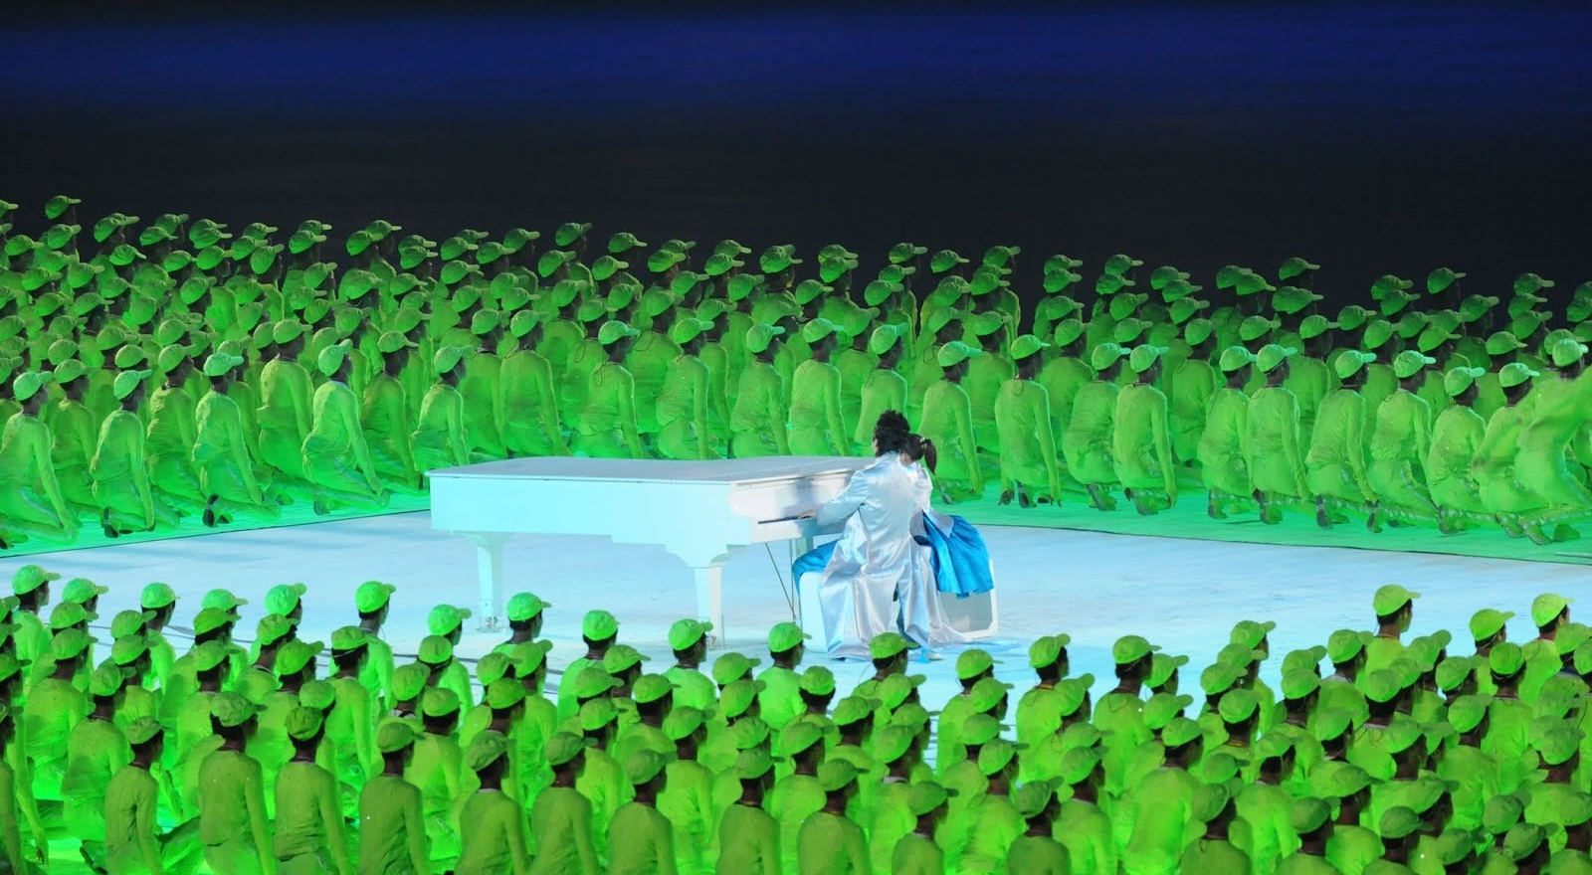
Notes:
Pic 7.5
Public domain http://upload.wikimedia.org/wikipedia/commons/c/cd/Chinese_pianist_Lang_Lang_the_Opening_Ceremony_of_the_2008_Olympic_Games.jpg

Slide 6
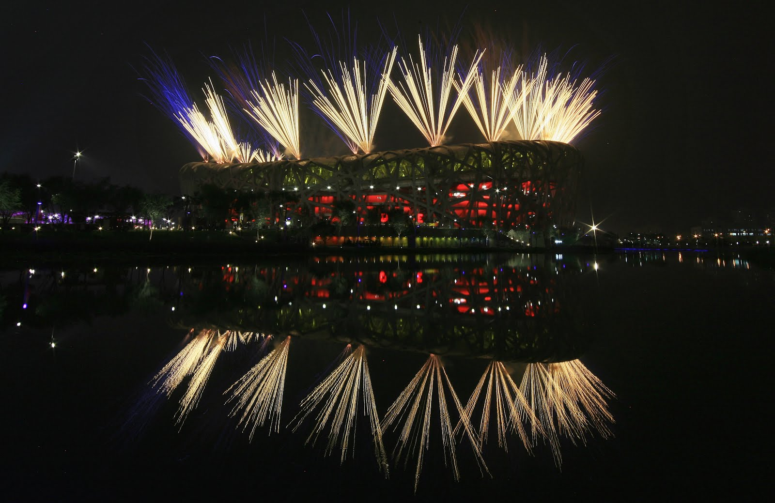
Notes:
Pic 6
Clive Rose/Getty Images http://www.thaindian.com/newsportal/v/olympics-2008/opening-ceremony_001/Beijing+Olympic+Opening+Ceremony+12.jpg.html

Slide 7
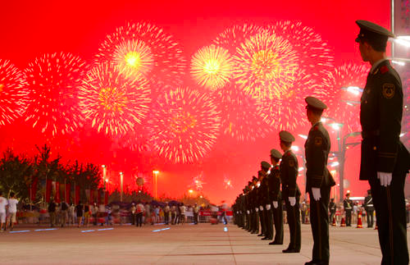
Notes:
Pic 5
China Photos/Getty Images http://www.thaindian.com/newsportal/v/olympics-2008/opening-ceremony_001/Beijing+Olympic+Opening+Ceremony+16.jpg.html

Slide 8
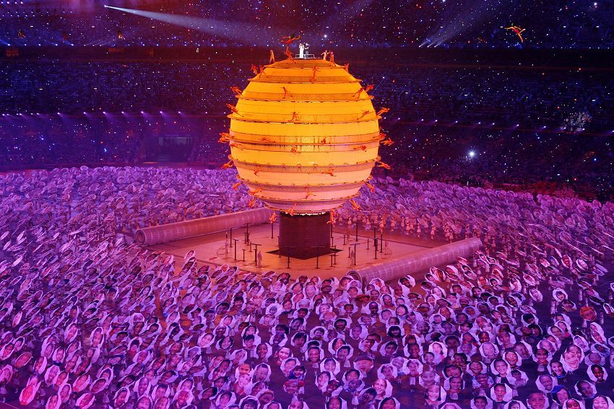
Notes:
Pic 4
Min Guo ? http://cnreviews.com/olympics/beijing_olympic_opening_ceremony_theme_song_singers_announced_20080806.html

Slide 9
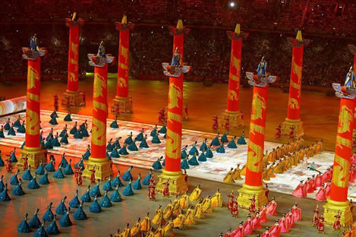
Notes:
Pic 3
Tim Wang http://blog.loaz.com/timwang/index.php/2008/08/08/beijing_2008_olympic_opening_ceremony_a_

Slide 10
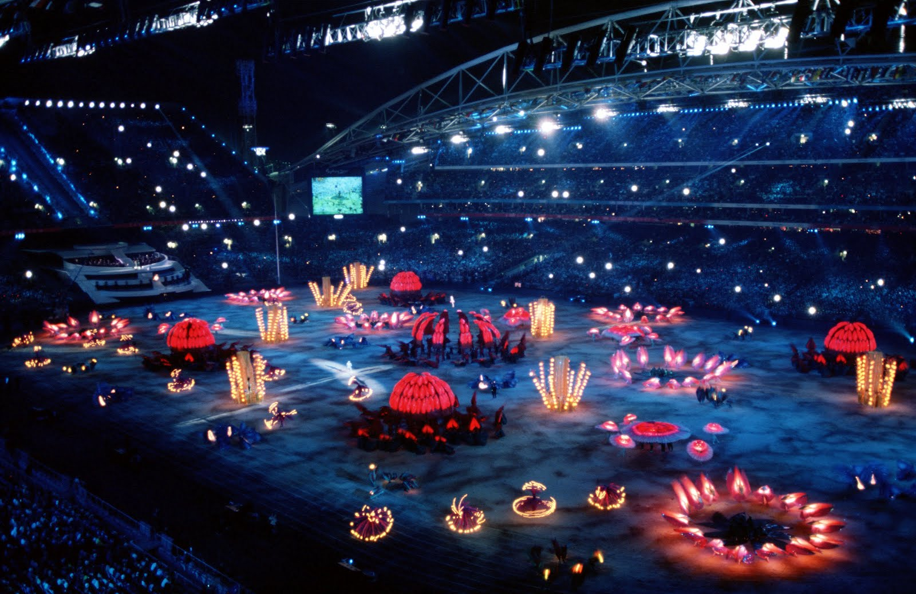
Notes:
Pic 24
Public domain http://upload.wikimedia.org/wikipedia/commons/8/8e/2000_Summer_Olympics_opening_ceremony_1.JPEG

Slide 11
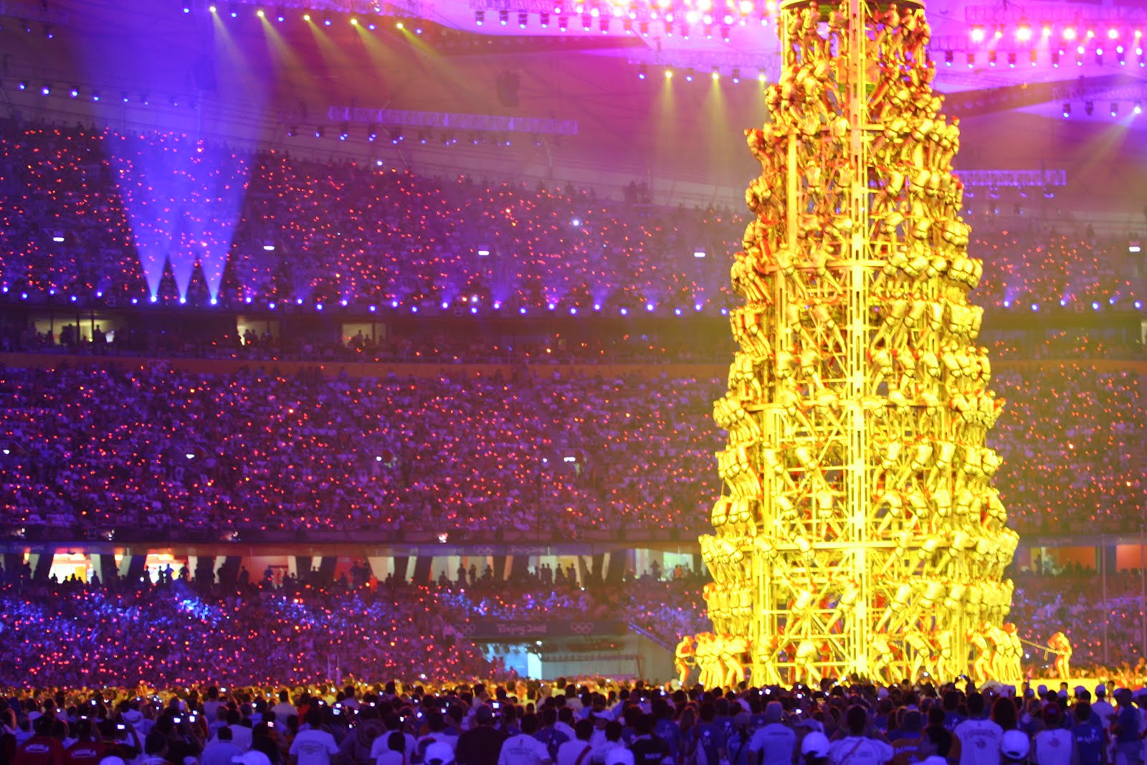
Notes:
Pic 23
By Richard Giles from Perth, Australia (Beijing Olympics: Closing Ceremony) [CC-BY-SA-2.0 (www.creativecommons.org/licenses/by-sa/2.0)], via Wikimedia Commons http://upload.wikimedia.org/wikipedia/commons/0/0c/Beijing_Olympics-_Closing_Ceremony.jpg

Slide 12
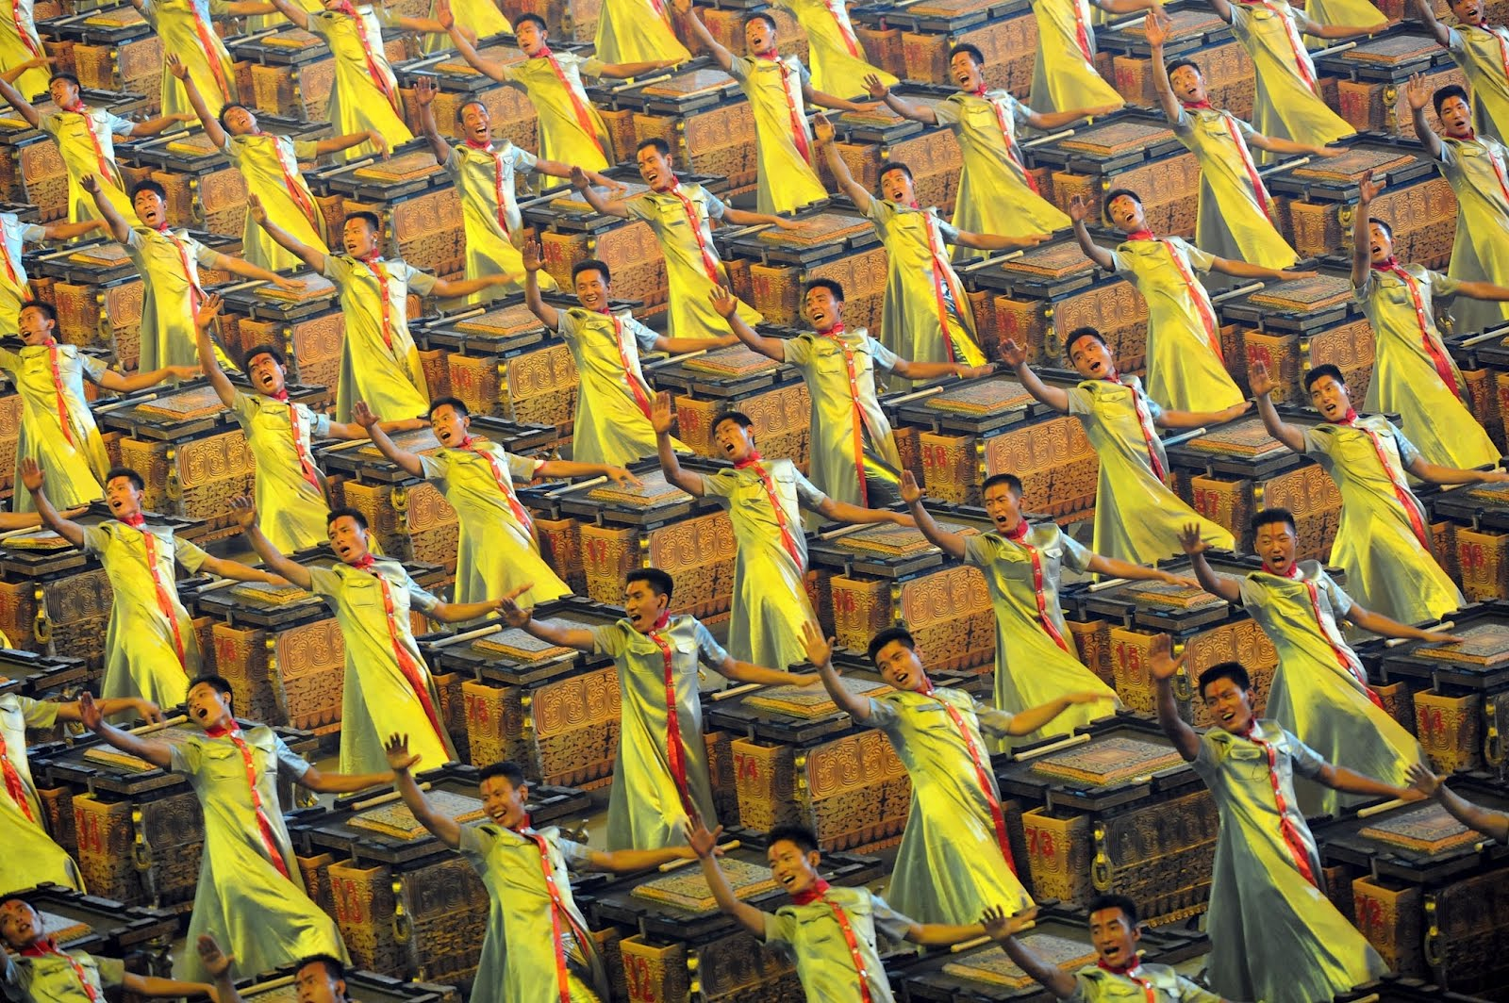
Notes:
Pic 22
Public domain http://upload.wikimedia.org/wikipedia/commons/a/af/Fou_performers_at_the_Opening_Ceremony_of_the_2008_Olympic_Games.jpg

Slide 13
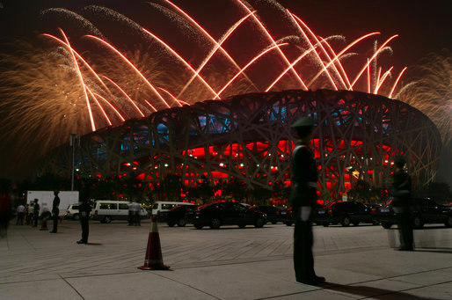
Notes:
Pic 21 Fireworks over China's National Stadium
Public domain http://upload.wikimedia.org/wikipedia/commons/7/7b/2008_Summer_Olympics_Opening_Ceremony_2.jpg

Slide 14
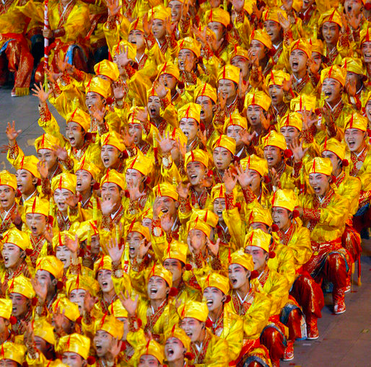
Notes:
Pic 20
Public domain http://upload.wikimedia.org/wikipedia/commons/1/1e/2008_Summer_Olympics_Opening_Ceremony_5.jpg

Slide 15
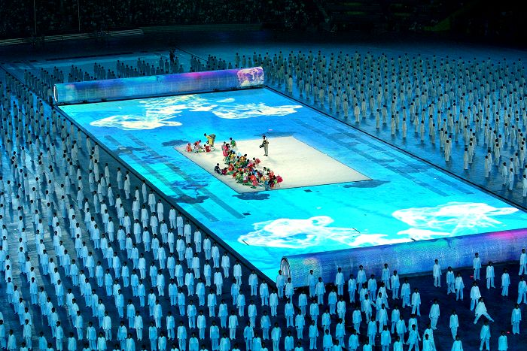
Notes:
Pic 2
By 江南秋雨 (http://cc.nphoto.net/view/2008/10801.shtml) [CC-BY-SA-2.5-cn (www.creativecommons.org/licenses/by-sa/2.5/cn/deed.en)], via Wikimedia Commons http://upload.wikimedia.org/wikipedia/commons/c/cc/2008_Summer_Olympics_opening_ceremony_2.jpg

Slide 16
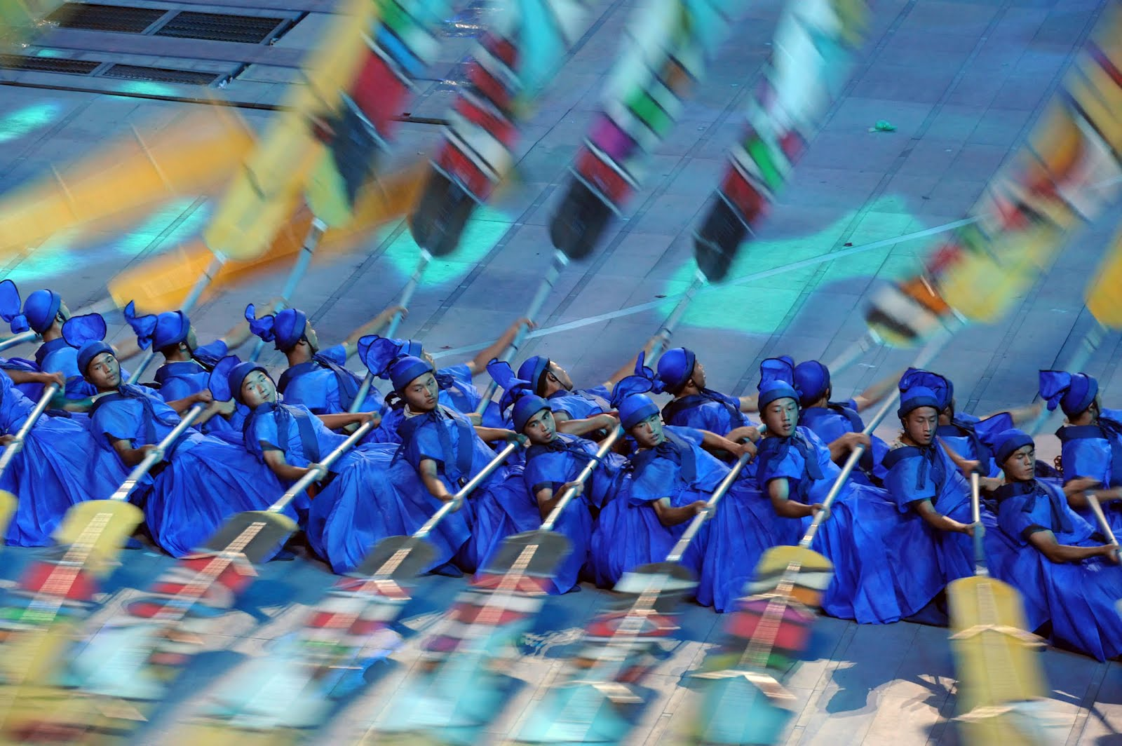
Notes:
Pic 19
Public domain http://upload.wikimedia.org/wikipedia/commons/a/a0/Rowers_during_2008_Summer_Olympics_opening_ceremony.jpg

Slide 17
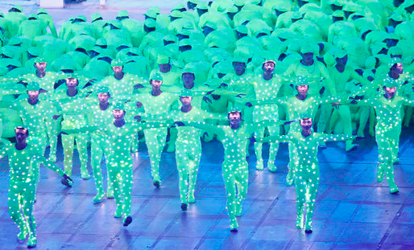
Notes:
Pic 17
Public domain http://upload.wikimedia.org/wikipedia/commons/0/04/2008_Summer_Olympics_Opening_Ceremony_9.jpg

Slide 18
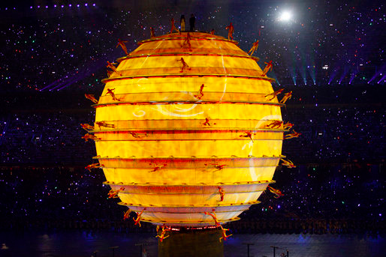
Notes:
Pic 16
public domain http://upload.wikimedia.org/wikipedia/commons/b/b6/2008_Summer_Olympics_Opening_Ceremony_4.jpg

Slide 19
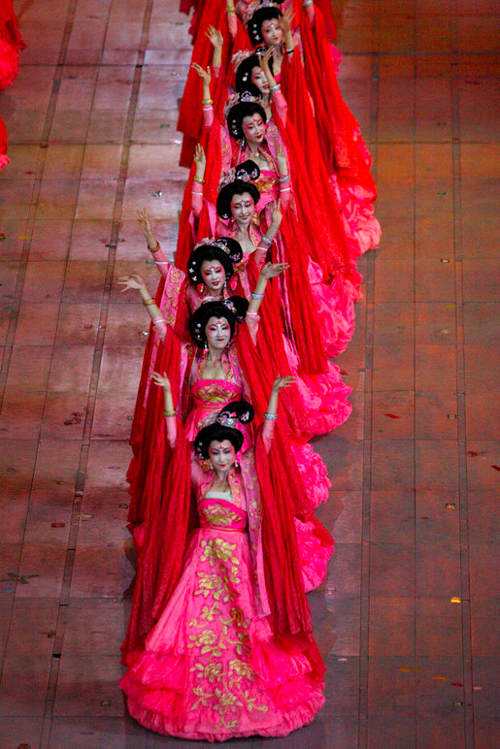
Notes:
Pic 15
Public domain http://upload.wikimedia.org/wikipedia/commons/8/87/2008_Summer_Olympics_Opening_Ceremony_8.jpg

Slide 20
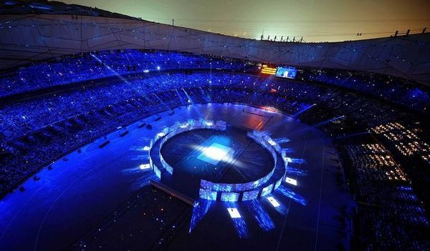
Notes:
Pic 14
? http://www.funonthenet.in/articles/olympics-opening-ceremony.html

Slide 21
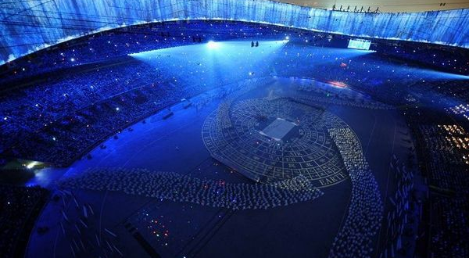
Notes:
Pic 13
? http://www.funonthenet.in/articles/olympics-opening-ceremony.html

Slide 22
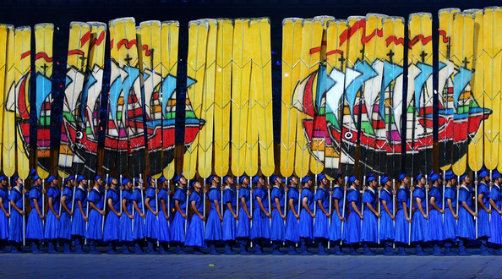
Notes:
Pic 12
Paul Gilham/Getty Images AsiaPac http://www.zimbio.com/2008+Olympic+Pictures/articles/50/PICTURES+2008+Beijing+Olympics+Opening+Ceremony

Slide 23
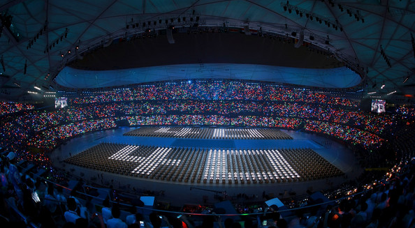
Notes:
Pic 11
Adam Pretty/Getty Images AsiaPac http://www.zimbio.com/2008+Olympic+Pictures/articles/50/PICTURES+2008+Beijing+Olympics+Opening+Ceremony

Slide 24
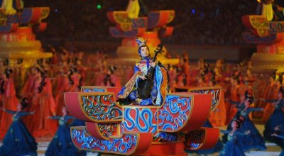
Notes:
Pic 10
Wow Cool Pics http://wowcoolpics.blogspot.co.uk/2008/08/awesome-photos-of-beijing-2008-olympic.html

Slide 25
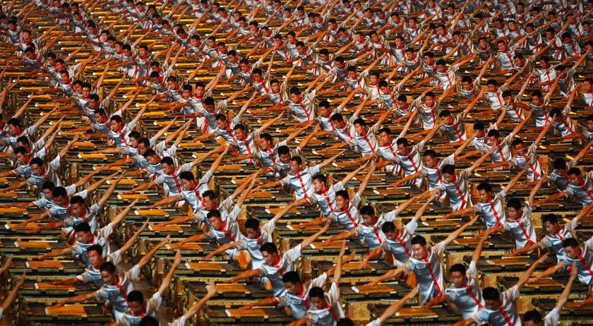
Notes:
Pic 1
1 Getty Images: Cameron Spencer http://www.abc.net.au/news/stories/2008/08/08/2329648.htm?site=olympics/2008

