Slide 1
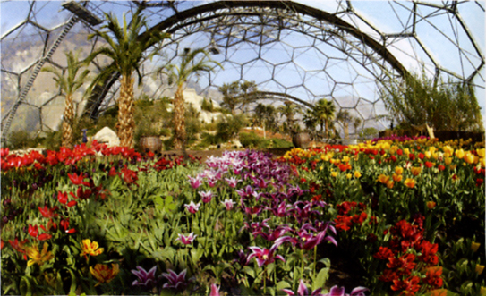
Terrariums

Slide 2
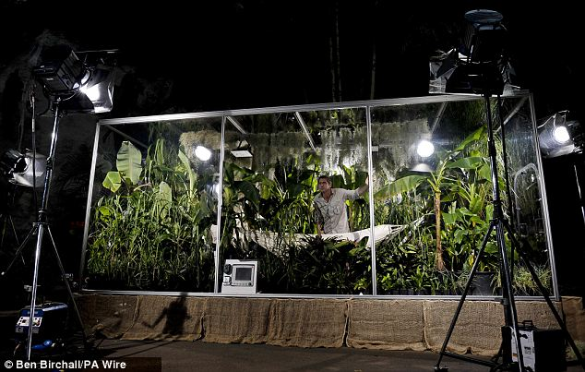
What is a Terrarium?
http://www.youtube.com/watch?v=1VNt0mwStZI

Slide 3
What do plants need?

Slide 4
What are the seven life processes?
M
R
S
G
R
E
N

Slide 5
What are the seven life processes?
Movement
Reproduction
Sensing
Growth
Respiration
Excretion
Nutrition
Where do plants get their energy from?

Slide 6
Photosynthesis
Carbon
Dioxide
Water
Glucose
Oxygen
Light
6CO₂
6H₂O
C₆H₁₂O₆
6O₂

Slide 7
Respiration
Carbon
Dioxide
Water
Glucose
Oxygen
Light
Energy
6CO₂
6H₂O
C₆H₁₂O₆
6O₂

Slide 8

Plants
Carbon
Dioxide
Glucose
Water
Oxygen

Slide 9
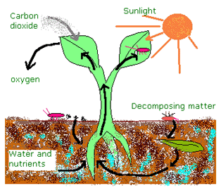
Nutrients

