Slide 1
Hello
We are Ziggy
And Ollie

Slide 2
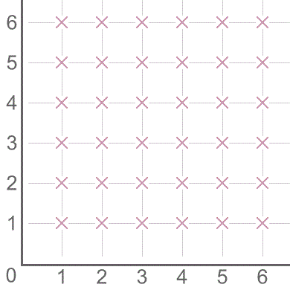
This is our work on the Are We Nearly There? challenge

Slide 3
The pattern is very simple the line goes up 1 step, diagonal 1 step, across 1 step, diagonal 2 steps, and so on.
Each new diagonal line is 1 step longer than the last diagonal line.

Slide 4
If the pattern continues for ever, which point will be the 100th point to be visited?
To work this out we drew out a larger copy of the pattern steps found out the coordinates
The answer was (9,6)

Slide 5
Can you design an alternative route that visits all the points on a grid?
Our route
This is the start of the
Original pattern
This is the start of our route
Ours however starts by going across then
Diagonal then up.
It’s the same but in a different order.
It goes up then diagonal then across

