Slide 1
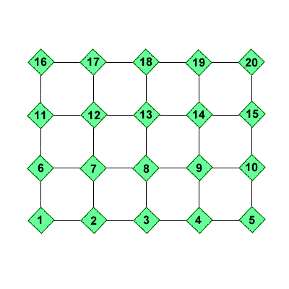
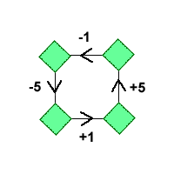
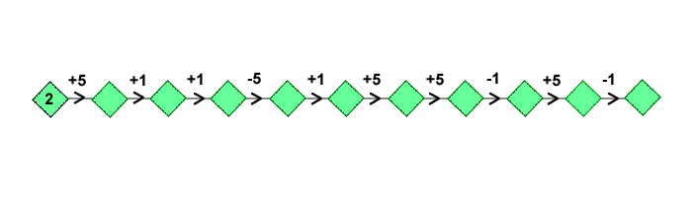
Routes 1 & 5
If you look at this grid you will see that when you move in different directions you add or subtract certain numbers. For example, moving one place to the right adds on one, moving up adds 5:
Find your way through the grid starting at 2 and following these operations:

Slide 2
number do you end on?
Find another way using these starting and end numbers, and record it in a similar way to the one above.
How can you use what you have done to find the shortest path between these two numbers?
18
2+5+1-1+5+5+1
=18
2+6+5+1+

