Slide 1

Solving the nice equation
With Ebi Akhilomen

Slide 2
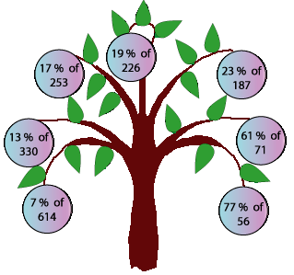
43.31- 42.9
17 percent of 253 → 43.01
13 percent of 330→42.9
7 percent of 614→ 42.98
77 percent of 56 → 43.12
61 percent of 71 → 43.31
23 percent of 187→43.01
19 percent of 226 → 42.94

Slide 3
0.41*244
100 .04 which is 100

