Slide 1
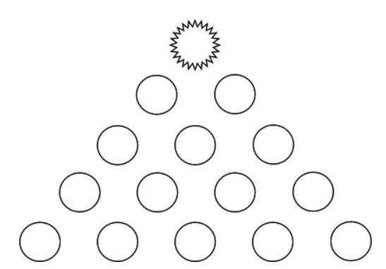
The highest number I could get was 190
190
106
84
56
60
24
14
42
18
6
2
7
6
3
2

