Slide 1
Number Machine

Slide 2
How does the number trick work?
Your chosen number → n
Add 3 → n + 3
Double → 2n + 6
Add 4 → 2n + 10
Halve → n + 5
Take away n → 5

Slide 3
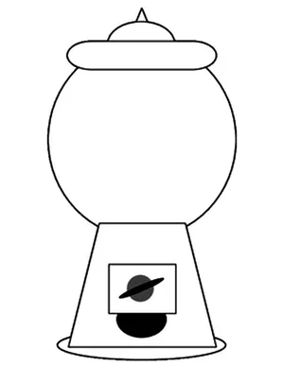


My trick
Choose a number.
Multiply by 2.
Add 10.
Divide by 2.
Subtract the number you started with.
1
8
Try again?
9
10
4
5
14
7
2
3
11
6
12
15
13

Slide 4
Choose a number.
Multiply by 2.
Add 26.
Divide by 2.
Subtract the number you started with.
1
8
9
10
4
5
14
7
2
3
11
6
12
15
13

Slide 5

How?
your number: $x$
multiply by 2: 2$x$
add 10: 2$x$ + 10
divide by 2: $x$ + 5
subtract $x$: 5
Same with 26 and 13

