Slide 1
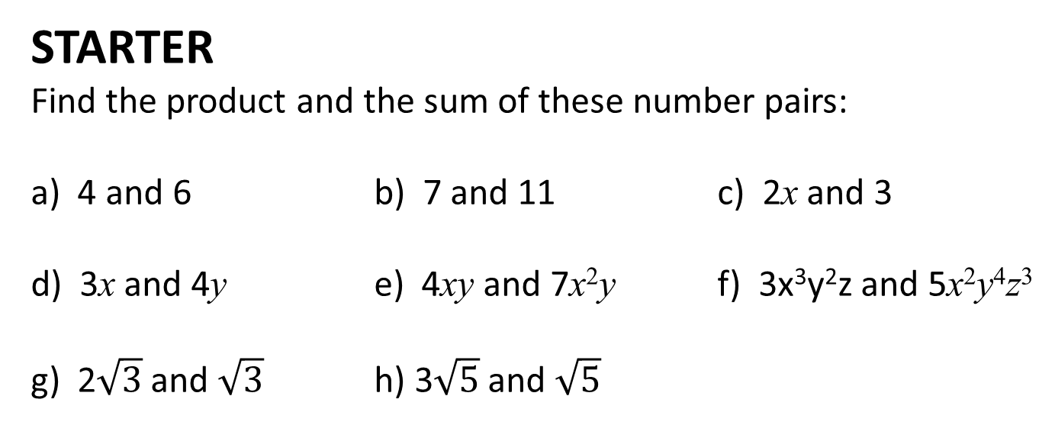
Algebraic Fractions
8 September, 2013
Grade B
L.O: To develop a better knowledge of how to manipulate algebra
SKILLS REQUIRED TODAY
Arithmetic, Logical Reasoning
STARTER
Find the product and the sum of these number pairs:
a) 4 and 6 b) 7 and 11 c) 2x and 3
d) 3x and 4y e) 4xy and 7x²y f) 3x³y²z and 5x²y⁴z³
g) 2$\sqrt{3}$ and $\sqrt{3}$ h) 3$\sqrt{5}$ and $\sqrt{5}$
KEY WORDS: Surds, Factorise, Simplify

Slide 2
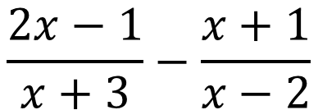
$$\frac{2x−1}{x+3}−\frac{x+1}{x−2}$$
You will be able to simplify this expression by the end of the lesson.
One thing that we need to be able to know is how we can simplify algebra through factorising

Slide 3
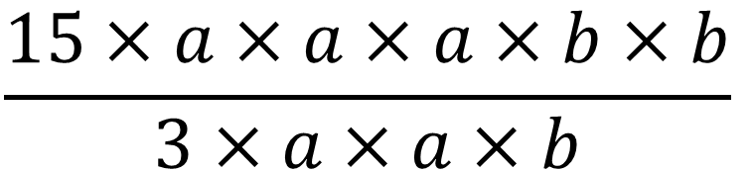
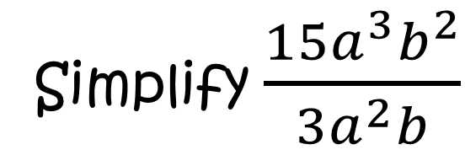
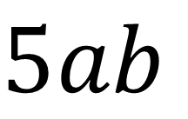
QUESTION
Simplify $\frac{15a^{3}b^{2}}{3a^{2}b}$
Write it out in parts
5
$$\frac{15×a×a×a×b×b}{3×a×a×b}$$
1
1
Cancel what you can
2
$$5ab$$

Slide 4
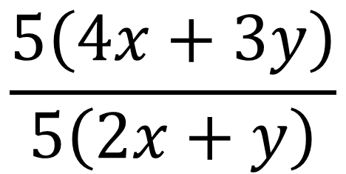
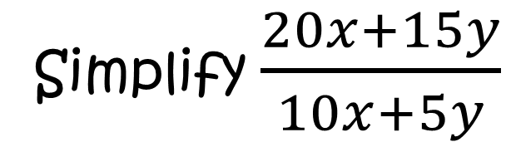
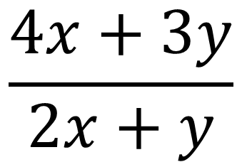
QUESTION
Simplify $\frac{20x+15y}{10x+5y}$
$$\frac{5\left(4x+3y\right)}{5\left(2x+y\right)}$$
1
Factorise
Cancel Common Factor
$$\frac{4x+3y}{2x+y}$$
2
You can only cancel when ALL terms have a common factor

Slide 5
REMEMBER
Only one term?
$$\frac{30a^{2}b}{5ab^{3}}$$
$$\frac{3a+6}{3a^{2}}$$
YES
NO
SIMPLIFY
FACTORISE
SIMPLIFY

Slide 6













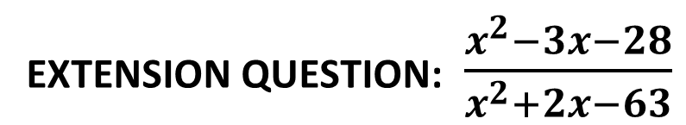
Your turn!
$$\frac{6a}{b^{2}}$$
1
$$\frac{30a^{2}b}{5ab^{3}}$$
4
$$\frac{6+2a}{3}$$
$$\frac{4ab+8a^{2}}{12a}$$
$$\frac{a+2}{a^{2}}$$
$$\frac{1+3x}{7}$$
2
$$\frac{3a+6}{3a^{2}}$$
5
$$\frac{3x+9x^{2}}{21x}$$
$$\frac{6x−42}{24}$$
3
$$\frac{x−7}{4}$$
6
$$\frac{1}{x+2}$$
$$\frac{x+3}{x^{2}+5x+6}$$
$$\frac{x+4}{x+9}$$
EXTENSION QUESTION: $\frac{x^{2}−3x−28}{x^{2}+2x−63}$

Slide 7
For those last two questions…
… you needed to remember how to factorise quadratics
Factors of 24
1 x 24 2 x 12 3 x 8
4 x 6
x² + 2x – 24
We need factors with a difference of 2, so 4 and 6
(x 4) (x 6)
How do we get +2 from 6 and 4?
(x – 4) (x + 6)

Slide 8
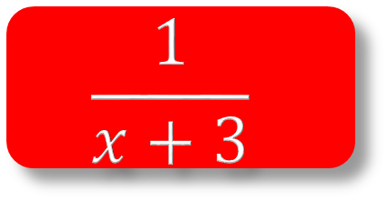

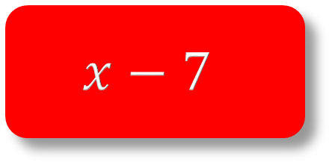


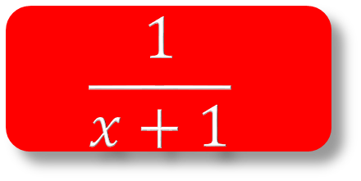
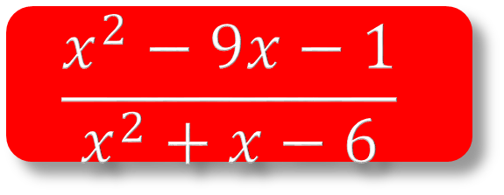



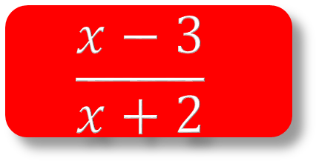
Your turn!
$$\frac{a^{2}−16}{2a^{2}+8a}$$
STUPIDLY
HARD EXT.
$$\frac{1}{x+1}$$
1
$$\frac{x+4}{x^{2}+5x+4}$$
2
$$\frac{1}{x+3}$$
$$\frac{x−2}{x^{2}+x−6}$$
3
$$x−7$$
4
$$\frac{x−3}{x+2}$$
$$\frac{x^{2}−2x−35}{x+5}$$
$$\frac{x^{2}+x−12}{x^{2}+6x+8}$$
$$\frac{2x−1}{x+3}−\frac{x+1}{x−2}$$
And that question from earlier…
$$\frac{x^{2}−9x−1}{x^{2}+x−6}$$

Slide 9
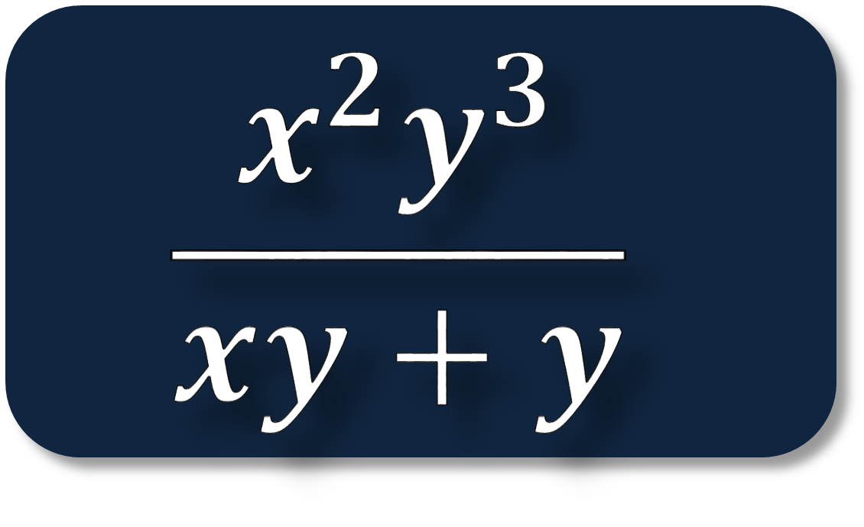
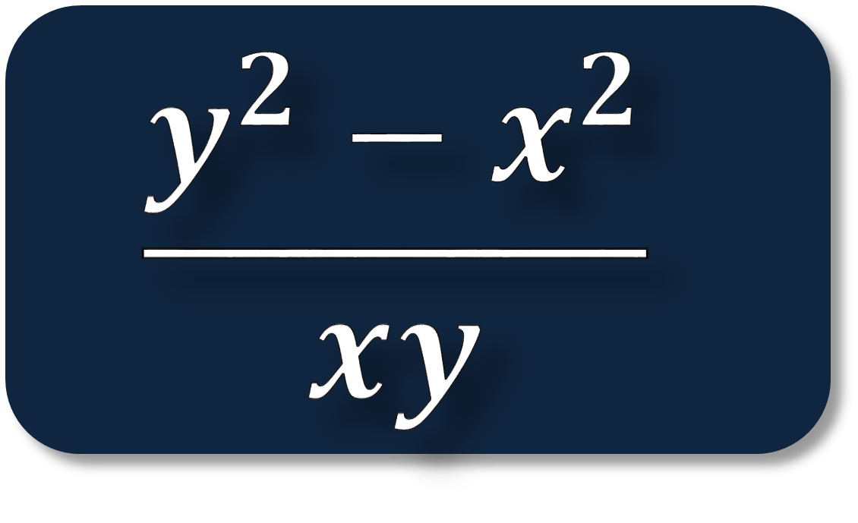
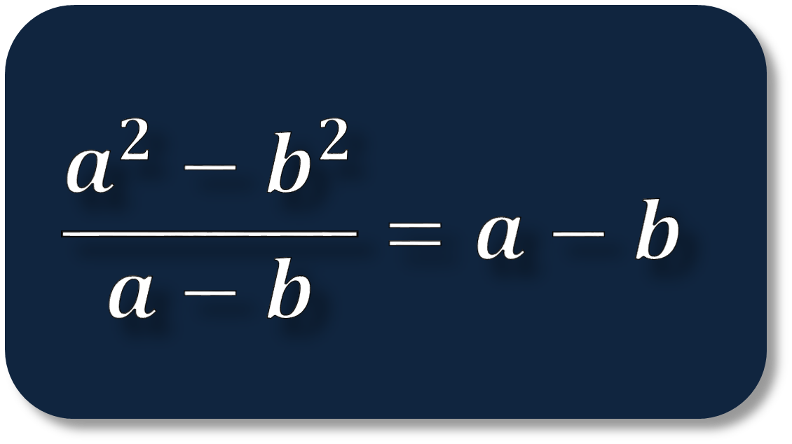
Can we simplify this?
True or False?
$$\frac{y^{2}−x^{2}}{xy}$$
$$\frac{x^{2}y^{3}}{xy+y}$$
$$\frac{a^{2}−b^{2}}{a−b}=a−b$$

Slide 10



Choose a statement that matches your ability on this topic so far
1
I now have a better understanding of manipulating algebra
2
I feel more comfortable with dealing with algebra now
1
I feel ok with algebra, but I feel that I might forget this
Copy the statement, and add a sentence detailing the easiest/hardest thing you have found
2
I need to practice more with fractions before working on this
1
I need to go away and work hard on fractions
2
I don’t understand anything we’ve covered in this topic

