Slide 2
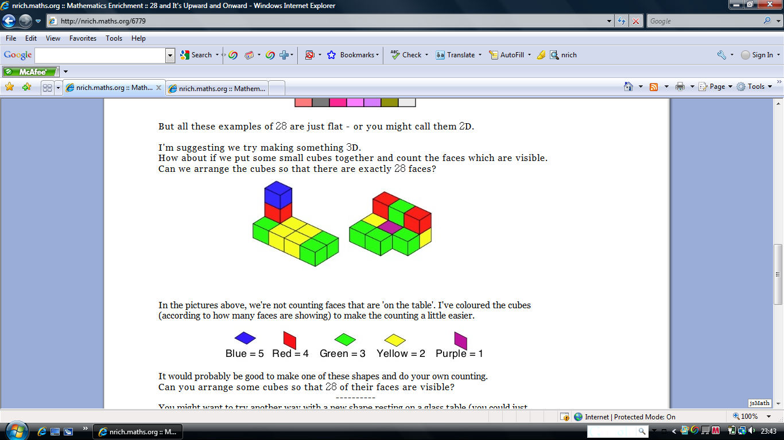
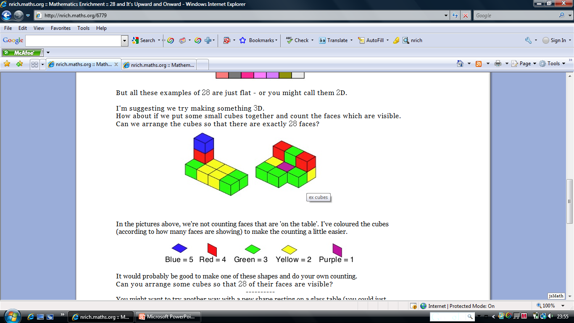
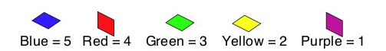
Y
G
1 x blue = 5
1 x red = 4
5 x yellow = 10
3 x green = 9
Total 28
0 x blue = 0
2 x red = 8
4x yellow = 8
4 x green = 12
0 x purple=0
Total 28

