Slide 1
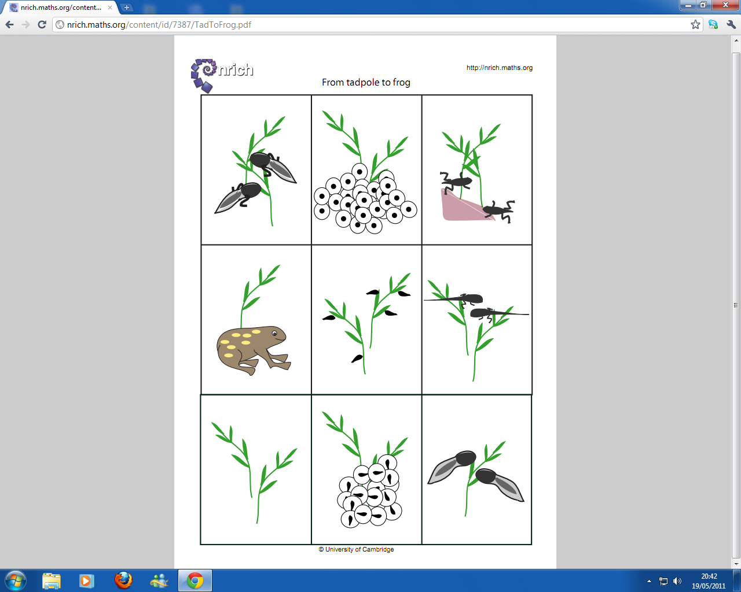
From Tadpole to Frog

