Slide 1
What I think ….

Slide 2
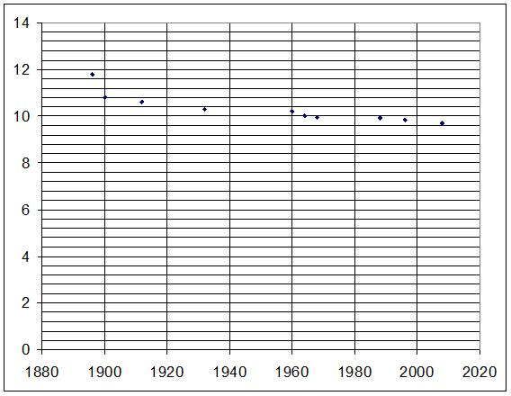
Graph 1…
I think this graph shows the men’s 100 meter. My reasoning for this is because I know that the world record for the men’s 100 meter is 9. seconds. The graph shows that the world record is set at 9.secounds. which then indicators that it was the men’s 100 meters. So the “Y” axis unit of measurement is in seconds.

Slide 3
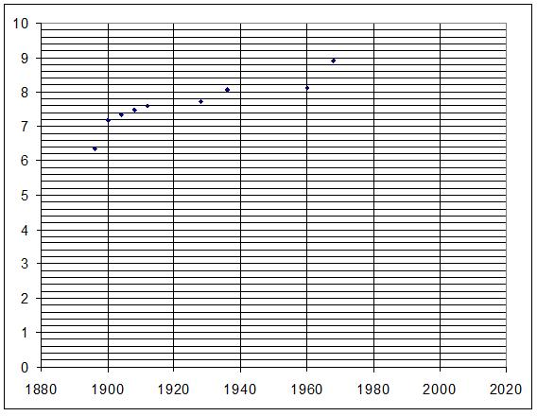
Graph 2 …
I think this graph shows men’s long jump. My reasoning for this is because all of the results get higher and higher each time. This indicators that they are getting better at the sport. So the “Y” axis is unit of measurement is in meters.

Slide 4
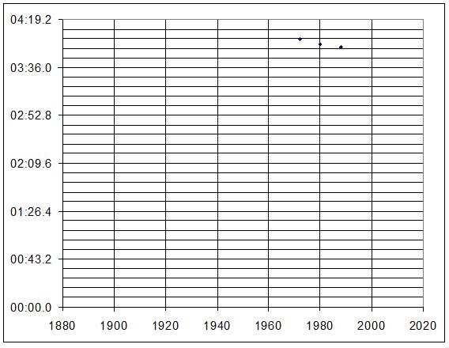
Graph 3…
I think this graph shows women’s 1500 meters. My reasoning for this is because this sport has not been going on for a while I know this because the sport is quite new to the Olympics and the time down the side indicators that it takes a while to do. So I concluded that it was the 1500 meter run. Which means the “Y” axis unit of measurement is in hours.

Slide 5
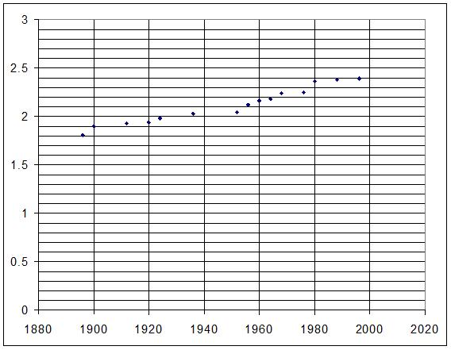
Graph 4 …
I think this graph shows men’s high jump. My reasoning for this is because the results are getting higher so the athletes are getting better at this sport.

Slide 6
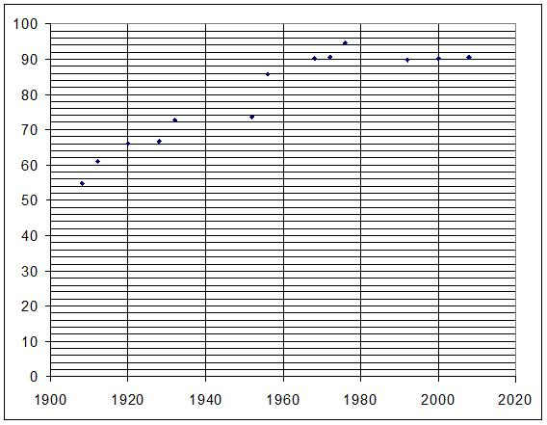
GRAPH 5…
I think this graph shows men’s Javelin. I think this because it starts of being quite low then getting higher and higher. Which means the unit of the measurement on the “Y” axis must be meter.

Slide 7
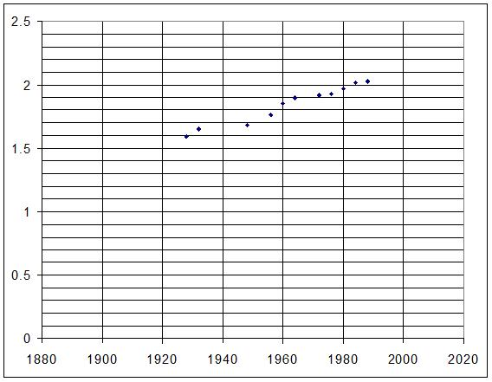
Graph 6…
I think this graph shows women’s high jump. I think this because it women’s high jump came in a bit later and the results are going up and getting higher. So the unit of measurement is in meters.

Slide 8
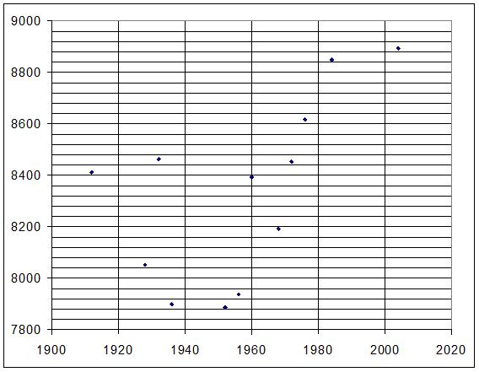
Graph 7…
I think this graph shows men’s decathlon. I think this because the results are very spread out because you get points for different things. So some could be better at other things. So the unit of measurement must be in seconds.

Slide 9
BY Megan heeley
Allenbourn
Middle
School.

Slide 10
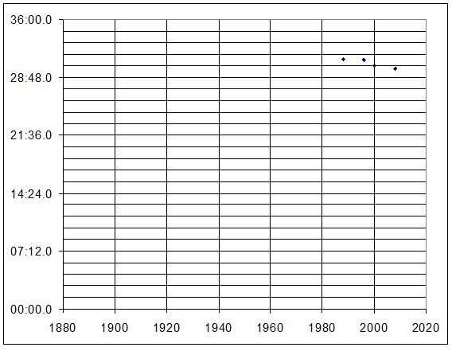
Graph 8…
I think this graph shows women’s 10,000 meters. I think this because this activity is very new so that is why there is only three dots on the graph. ON the “Y” axis it looks like the activity goes on for a while so that is my reason for choosing the women’s 10,000 meters. So the unit of measurement on the “Y” axis is hours.

Slide 11
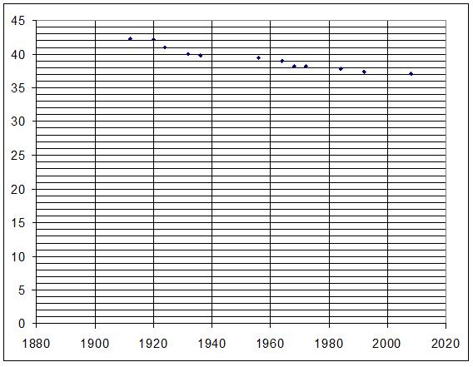
Graph 9…
I think this graph shows men’s 4x100 meters relay. My reasoning for this is because I worked out that each sprint was 10 seconds. This sport looks like it has been around for a couple of years but not long. I think the unit of measurement on the “Y” axis is in seconds.

Slide 12
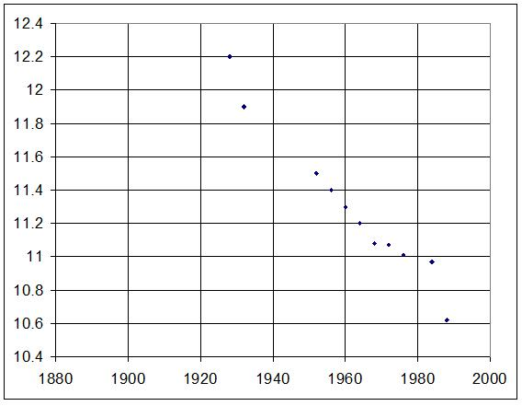
Graph 10…
I think this graph shows women’s 100 meter’s. I think that because the results have got quicker which means they are getting a quicker times. I think the unit of measurement of “Y” axis is in seconds.

