Slide 1
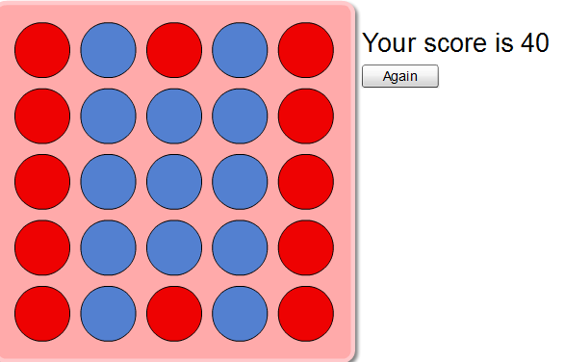
Key
Groups of Three
Groups of Five

