Slide 1
Nrich Nine Colours Solution
By Oengus Swan

Slide 2
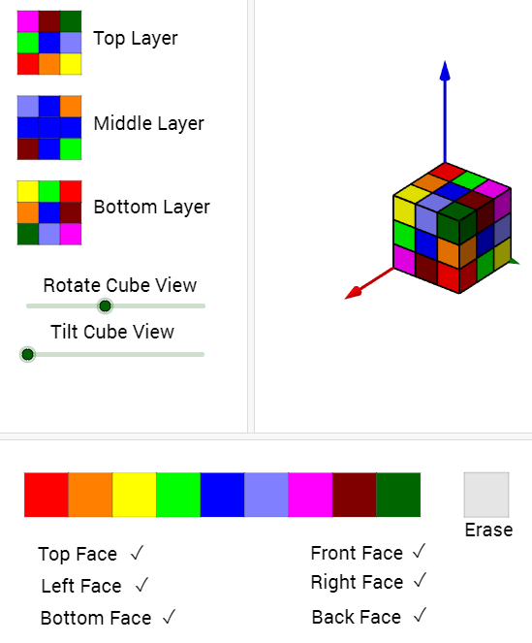
Nine Colours is an nrich problem in which you have 27 cubes, (there are 9 colours). You have to make a 3 by 3 by 3 cube with all the small cubes. But on each face of the big cube there cannot be a repeated colour, which means we need 1 colour on every face. The aim is to make the cube similar to the cube on the left - with all the rules of above.

Slide 3
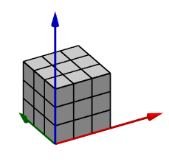
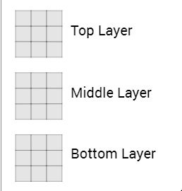
Layers
The layers are simple, what Nrich shows in the picture on the right is the top middle and bottom layer (this is also where you fill the colours in to solve the problem)
This cube here doesn’t matter at all because when it is in the middle of the cube, out of sight, it is not on any face, leave it blank if you want, if you colour it that is just fine.

Slide 4
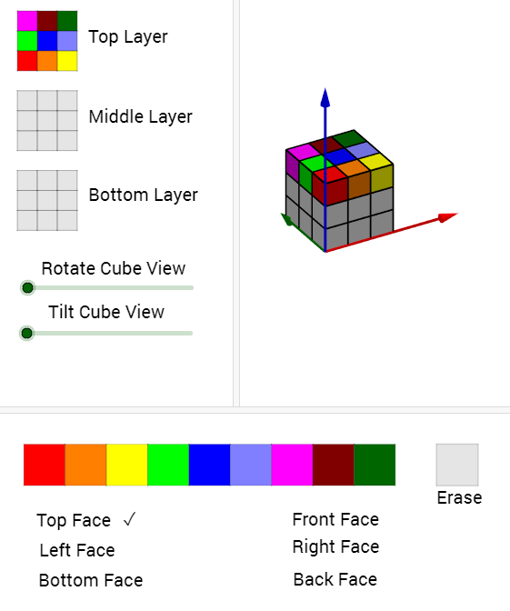
Step 1 - The Top Layer
We naturally start off with a blank cube, which we have to fill in.
Quickly we have finished the top layer and face
Firstly, we fill the whole top layer with random colours of your choice, but not using the same colour twice. Like this!

Slide 5
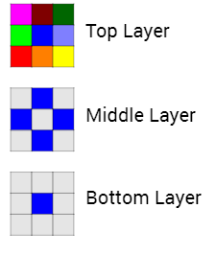
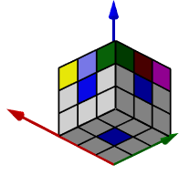
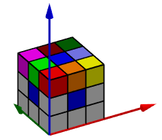
Step 2 - Eliminating a Colour
Next, you figure out which colour you put in the middle of the top layer - in this case blue - and put them in the middle of every face, this makes sure that your blue cannot be a cause in a mistake as it is definitely not on the same face as another. Now the colour blue is eliminated as it is on every face, this way, you don’t have to worry about it anymore.

Slide 6
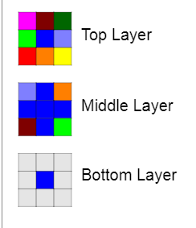
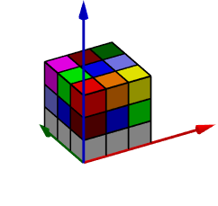
Step 3 - The middle layer
After we have eliminated a colour, the middle layer only needs 4 cubes to finish it. The corners of the layer.
As you can see on the picture on the right, we have just looked at the pieces with next to the blue piece on top, namely: grey on the right, orange behind, green on the left and brown in front
We duplicate them on the layer below but put them on the other side of the layer and move them left once.
Down 1 layer
Turned to the other side and moved left once.
There are many ways to make sure without checking that a face doesn’t have the same colours on it.

Slide 7
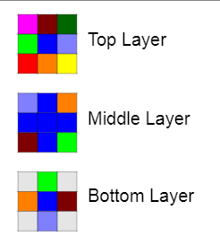
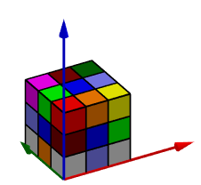
Step 4 - The bottom layer/face Part 1
As you can see I have used the same colours as the last step and done exactly the same actions as last step. But there is one difference: instead of moving the colour left once, I move it right, which again makes sure that we do not have the same colour on one face.

Slide 8
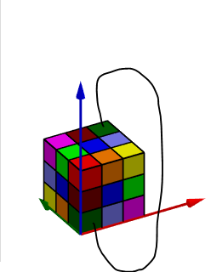
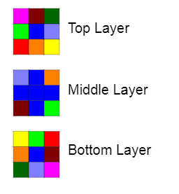
Step 5 - The bottom layer/face part 2
The final step, the simplest of them all, all we have to do is get the corners from the top layer, and put them opposite on the bottom layer, like shown in the image to the right.
Now the cube is complete and solved

