Slide 1
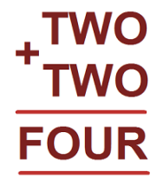
You can put down any numbers as long as T+T=O
e.g.
However, if T= a number that is 5 or over this method will not work because O would equal a two digit number.

